Slide 1
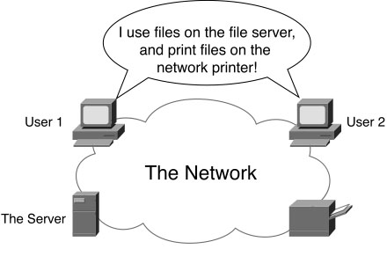
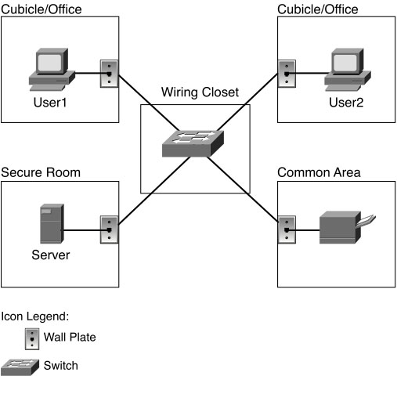
What is a network?
“Combination of hardware, software, and cabling, which together allow multiple computing devices to communicate with each other.”
“Gives computers the ability to communicate”
Differences are primarily those of scale
Often clouds in diagrams
Notes:
Quotations from page 5 of Computer Networking First-Step by Wendell Odom (Cisco Press, 2004)
Figures 1-1 and 1-2 from Computer Networking First-Step by Wendell Odom (ISBN: 1587201011) Copyright © 2013 Cisco Systems, Inc. All rights reserved.

Slide 2
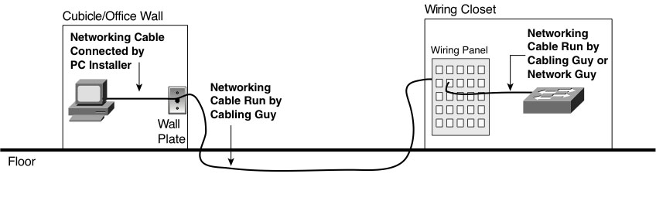
The electrician’s perspective
Cables connecting each wall plate to wiring panels in wiring closets
Conduit
Cable runs
Notes:
Figure 1-4 from Computer Networking First-Step by Wendell Odom (ISBN: 1587201011) Copyright © 2013 Cisco Systems, Inc. All rights reserved.

Slide 3
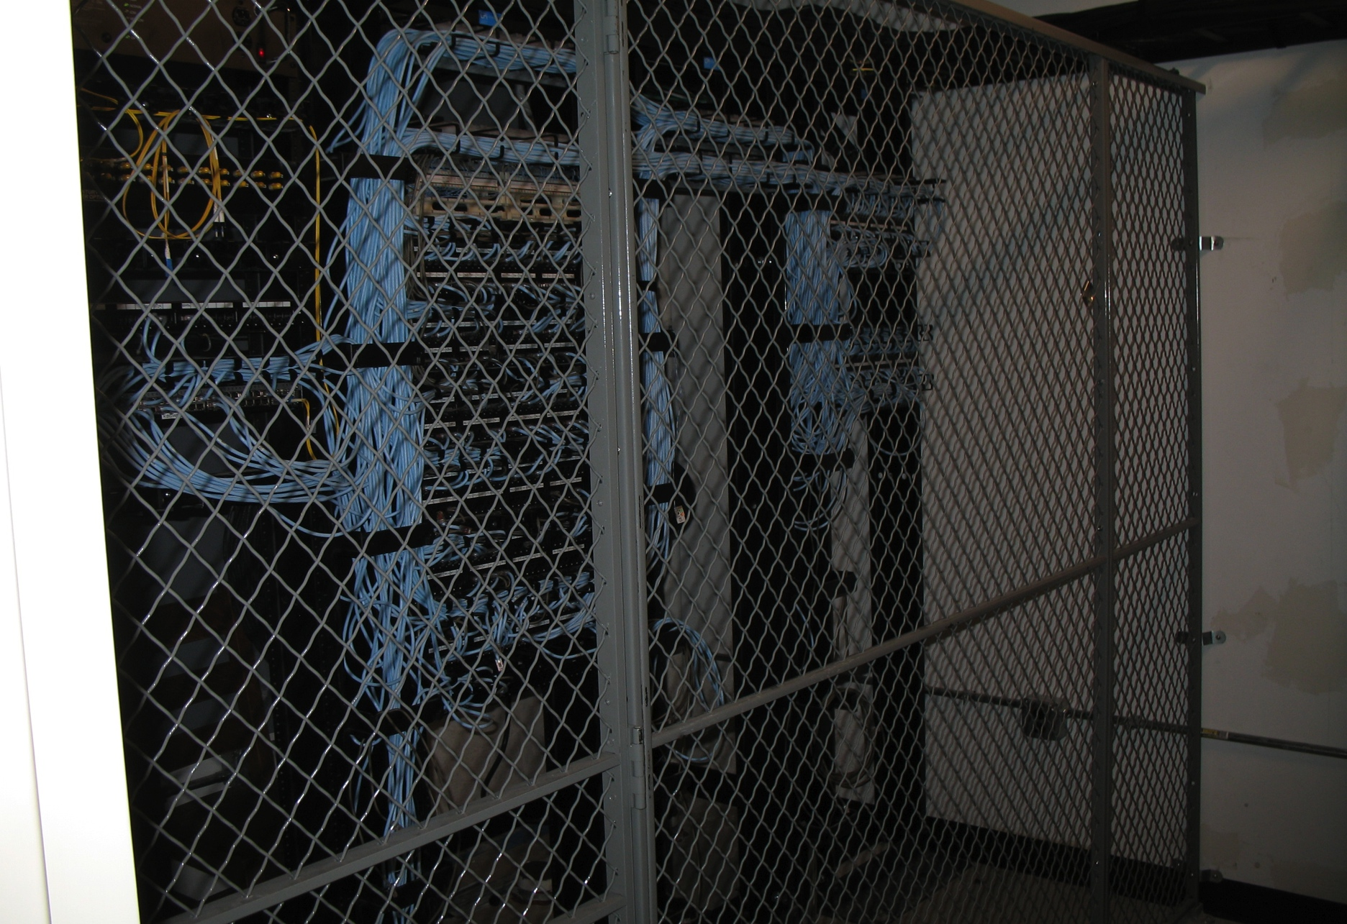
The wiring closet
Notes:
Photo Copyright © 2012 Mike Gildersleeve. All rights reserved.

Slide 4
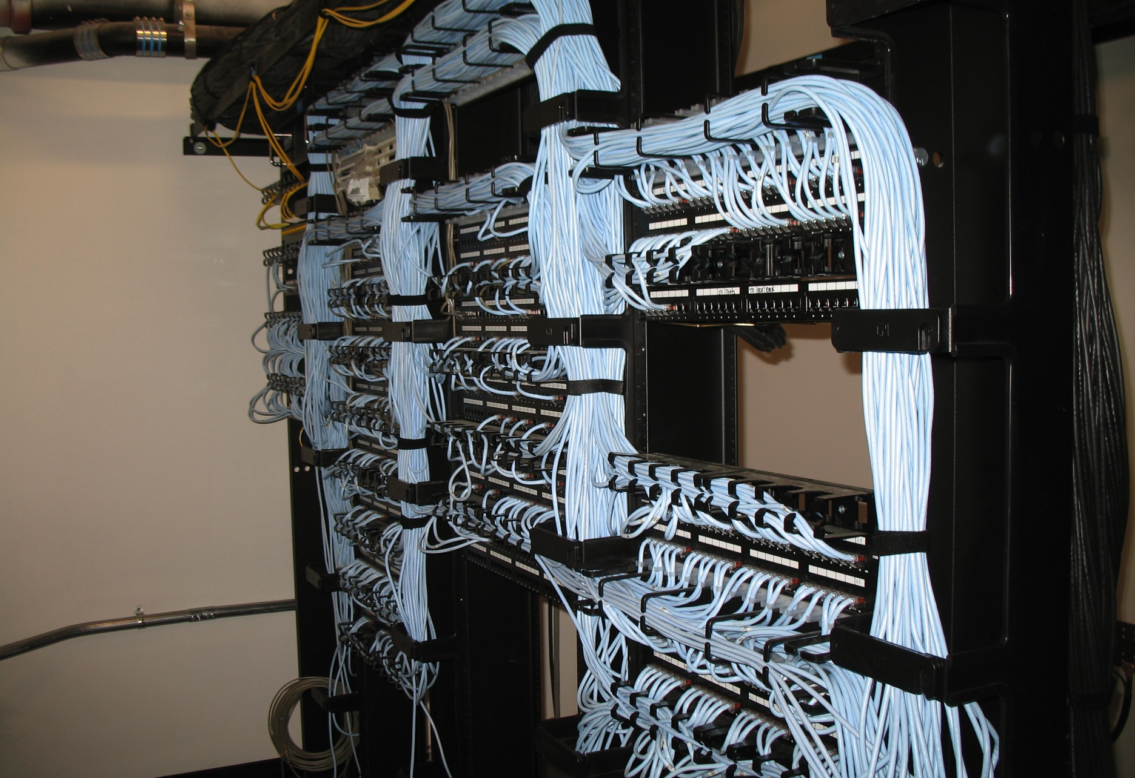
The wiring closet
Notes:
Photo Copyright © 2012 Mike Gildersleeve. All rights reserved.

Slide 5
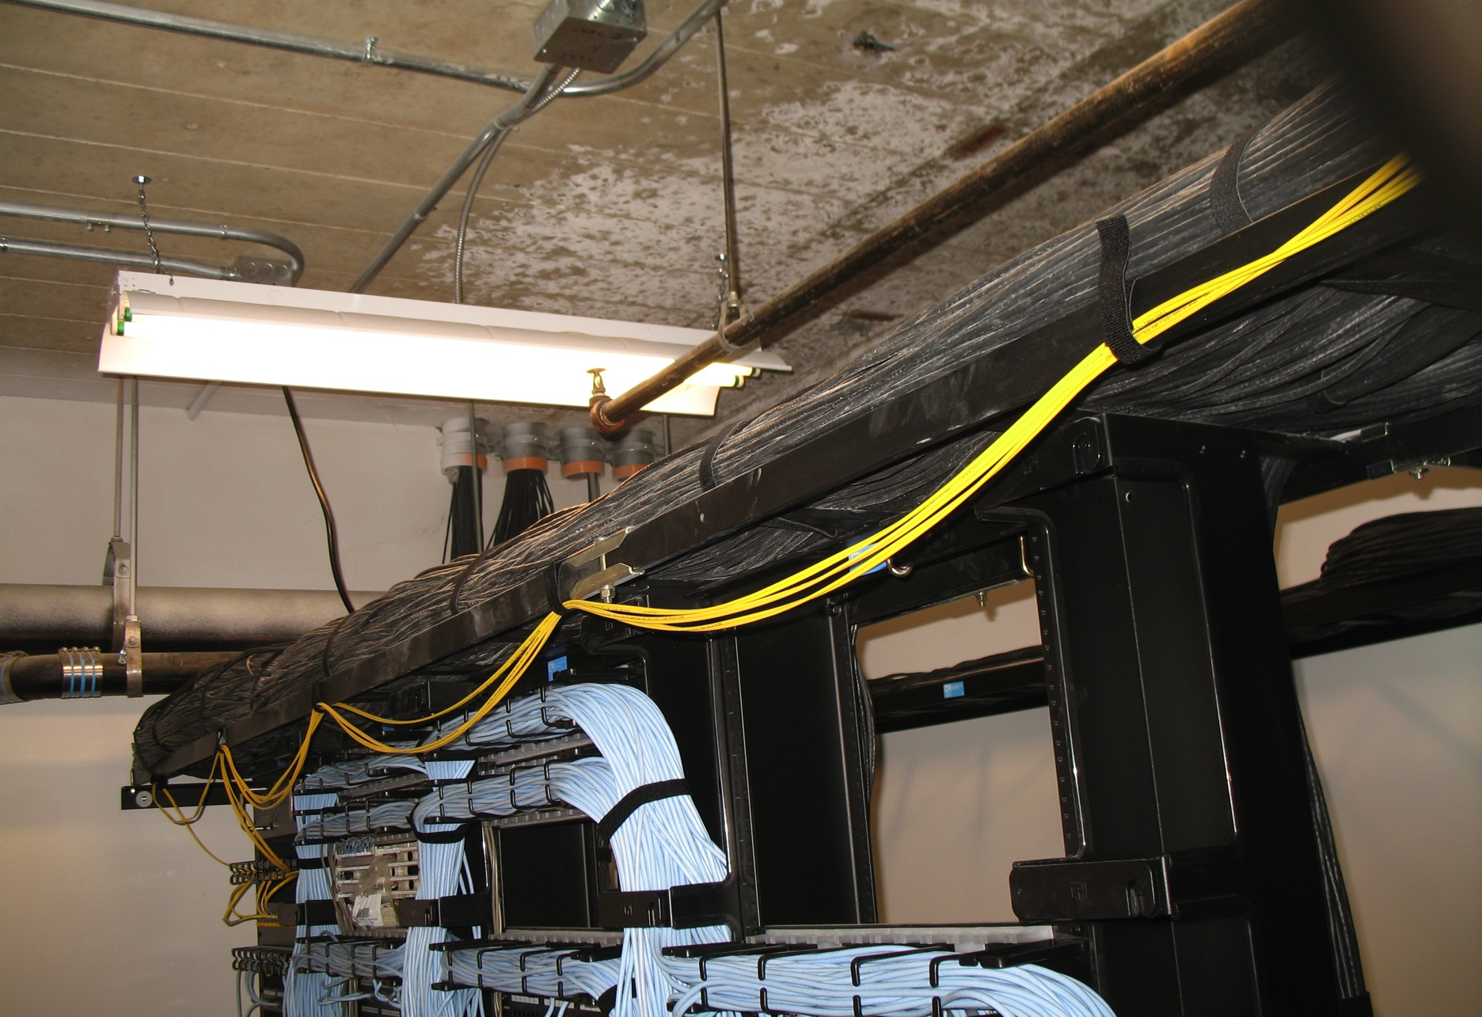
The wiring closet
Notes:
Photo Copyright © 2012 Mike Gildersleeve. All rights reserved.

Slide 6
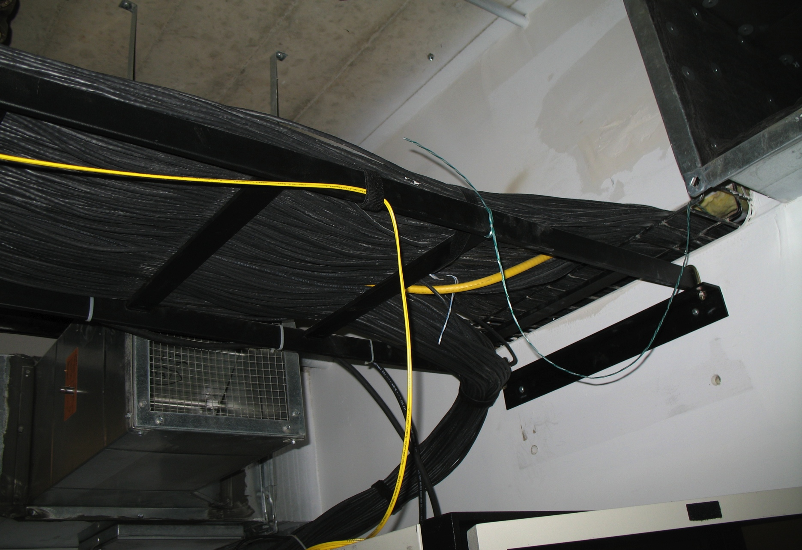
The wiring closet
Notes:
Photo Copyright © 2012 Mike Gildersleeve. All rights reserved.

Slide 7
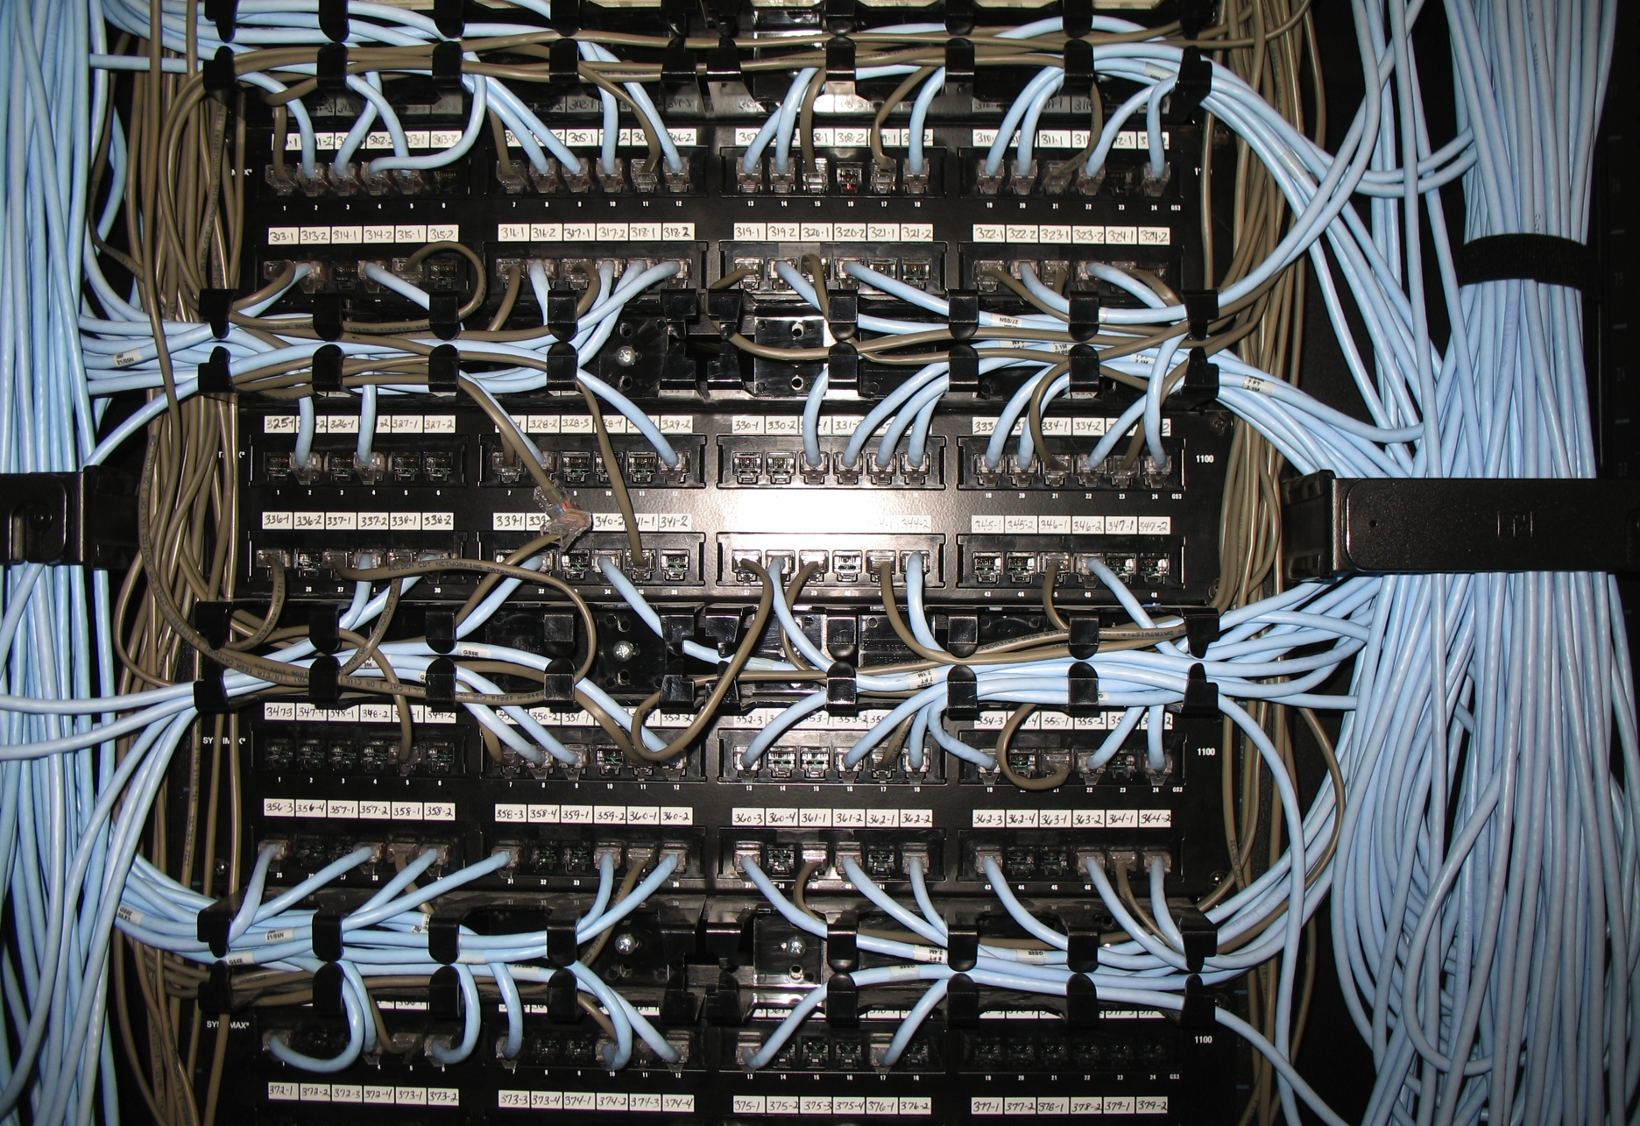
The wiring panel
Notes:
Photo Copyright © 2012 Mike Gildersleeve. All rights reserved.

Slide 8
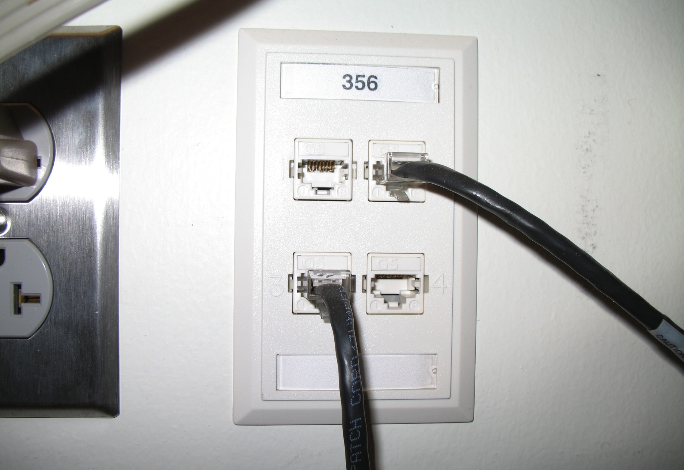
The wall plate
Notes:
Photo Copyright © 2012 Mike Gildersleeve. All rights reserved.

Slide 9
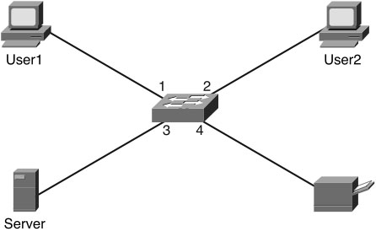
The network engineer’s perspective
Patch cables connecting ports on wiring panels to switches
Each wiring panel port represents a device
Switches connect those devices to one another as needed
Notes:
Figure 1-5 from Computer Networking First-Step by Wendell Odom (ISBN: 1587201011) Copyright © 2013 Cisco Systems, Inc. All rights reserved.

Slide 10
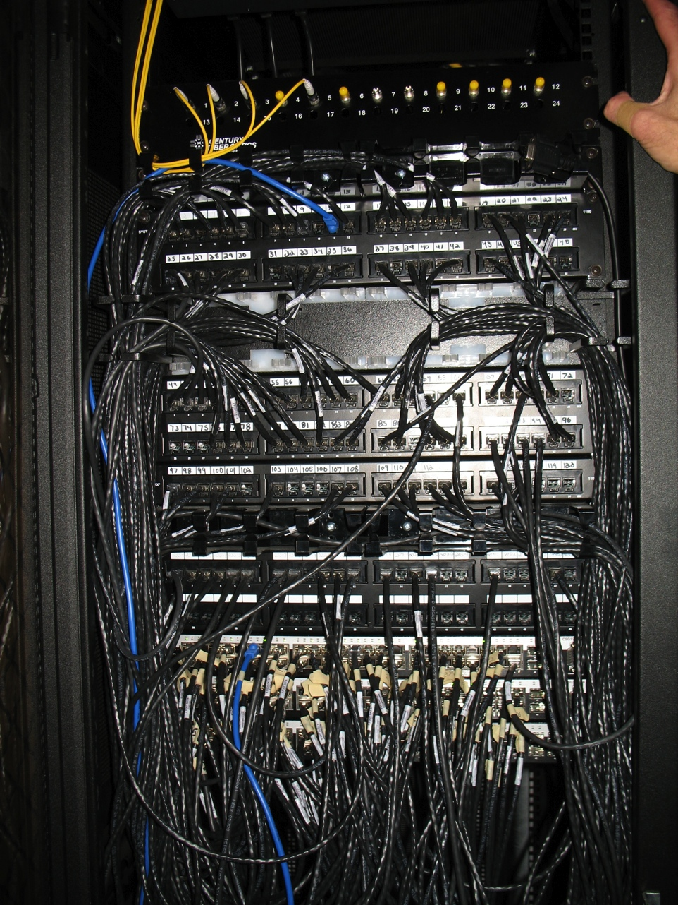
The switch stack
Notes:
Photo Copyright © 2012 Mike Gildersleeve. All rights reserved.

Slide 11
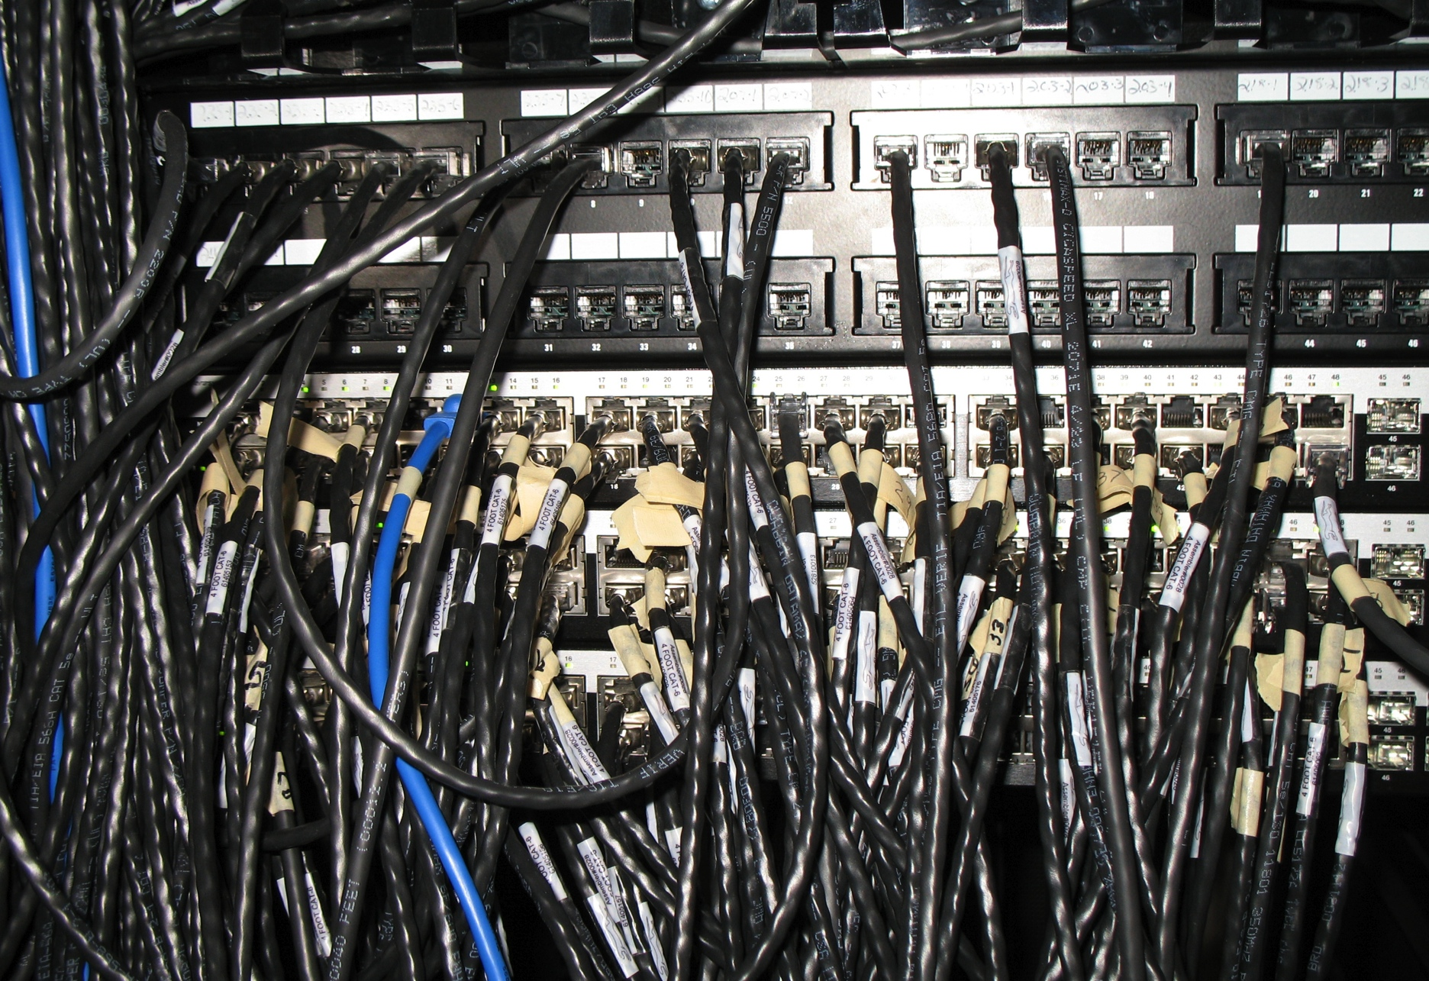
The switch stack
Notes:
Photo Copyright © 2012 Mike Gildersleeve. All rights reserved.

Slide 12
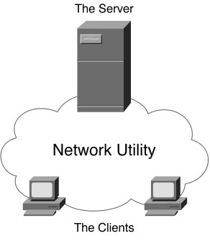
The server administrator’s perspective
Network utility
Cloud
Notes:
Figure 1-3 from Computer Networking First-Step by Wendell Odom (ISBN: 1587201011) Copyright © 2013 Cisco Systems, Inc. All rights reserved.

Slide 13
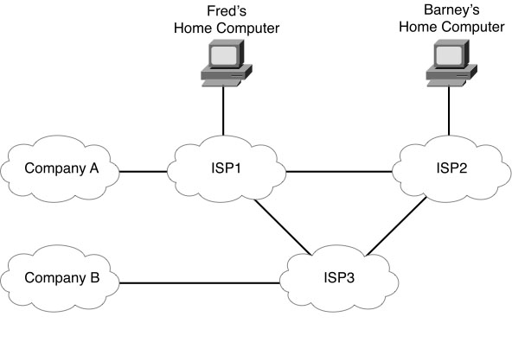
The user’s perspective
Most don’t need or want to know how it works
Network utility accessible through wall jack
Like electricity
Magic clouds
Network services
Notes:
Figure 2-5 from Computer Networking First-Step by Wendell Odom (ISBN: 1587201011) Copyright © 2013 Cisco Systems, Inc. All rights reserved.

Slide 14
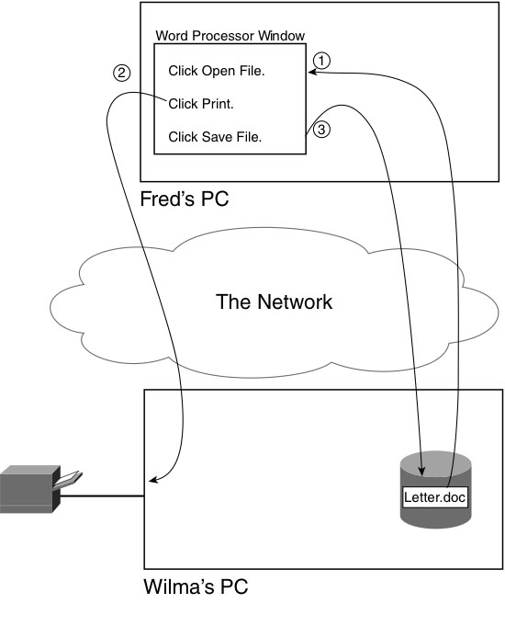
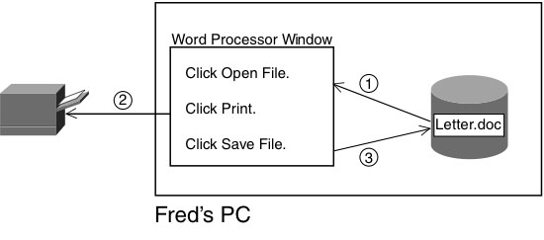
“Accidental” network usage
User doesn’t even know he’s using the network
Transparent
“Sneakernet”
File access
File server
Printing services
Print server
Notes:
Figures 2-1 and 2-5 from Computer Networking First-Step by Wendell Odom (ISBN: 1587201011) Copyright © 2013 Cisco Systems, Inc. All rights reserved.

Slide 15
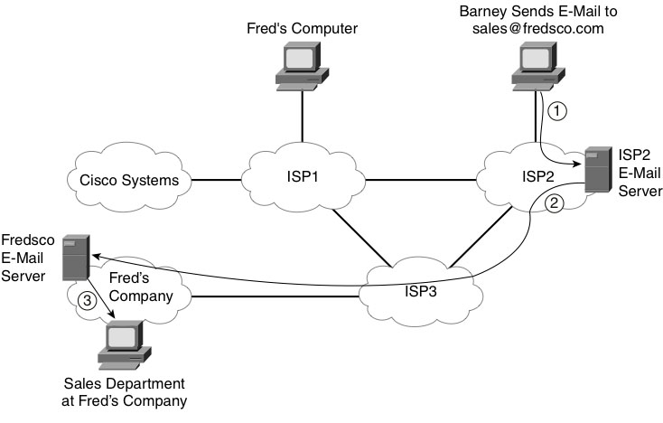
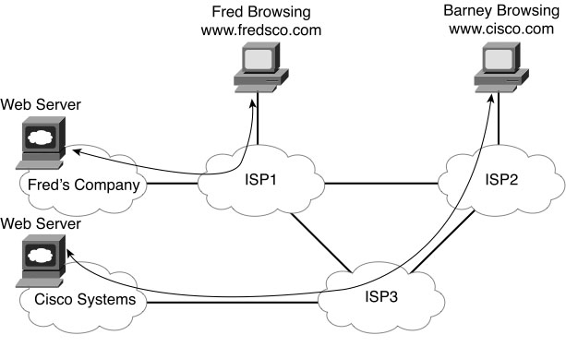
“Intentional” network usage
User has some idea the network is required
Often involves the Internet via an ISP
Phone or cable modem
Internet services – client/server model
E-mail – e-mail client, e-mail server, “snail mail”
World Wide Web – browser, web server, pages, URLs, sites/presentations
File Transfer – FTP client, FTP server, upload/download
Differs from file access
Notes:
Figures 2-8 and 2-5 from Computer Networking First-Step by Wendell Odom (ISBN: 1587201011) Copyright © 2013 Cisco Systems, Inc. All rights reserved.

Slide 16
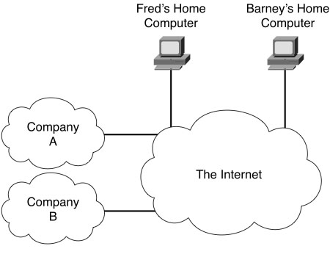
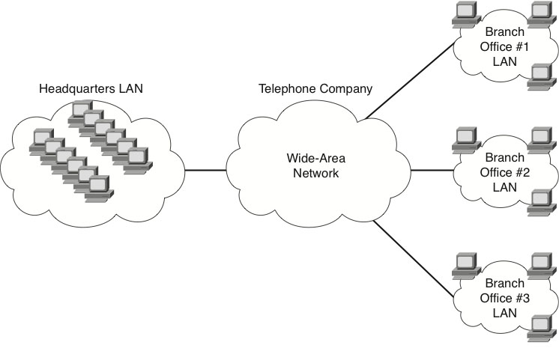
Types of networks
Local area network – LAN
Previous figures
Connects computers that are close together
Wide area network – WAN
Connects several LANs at different sites
Enterprise network or enterprise WAN
The Internet
Connects LANs and WANs all over the world
Internet Service Provider – ISP
Notes:
Figures 1-6 and 1-7 from Computer Networking First-Step by Wendell Odom (ISBN: 1587201011) Copyright © 2013 Cisco Systems, Inc. All rights reserved.

Slide 17
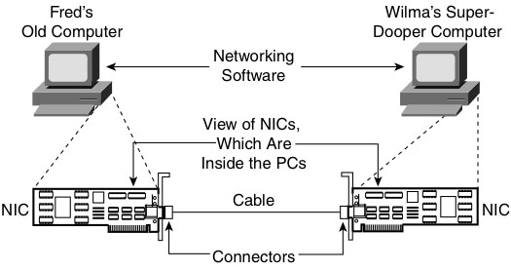
Networking standards
Sets of rules for creating networking products
More general than protocols
Cables, hardware, software
Interoperability
Physical connectivity
Devices, NICs, and cabling – path for data
Connectors – keyed by shape, size, pins, etc.
Notes:
Figure 3-1 from Computer Networking First-Step by Wendell Odom (ISBN: 1587201011) Copyright © 2013 Cisco Systems, Inc. All rights reserved.

Slide 18
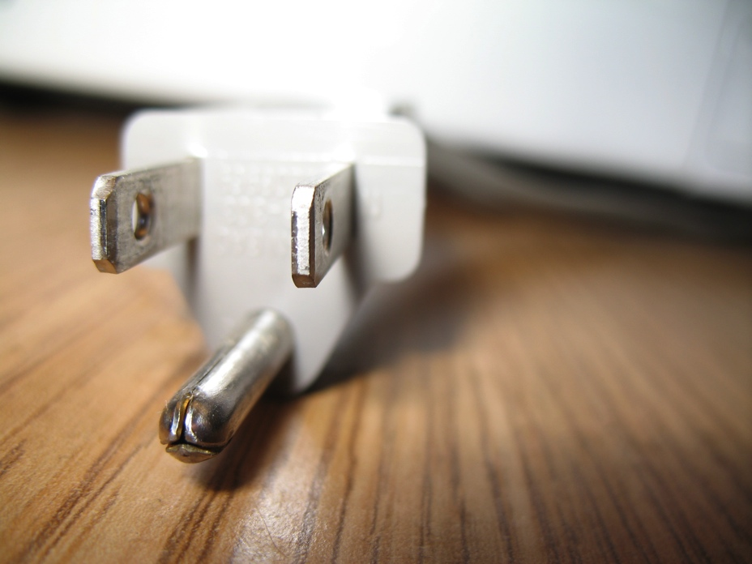
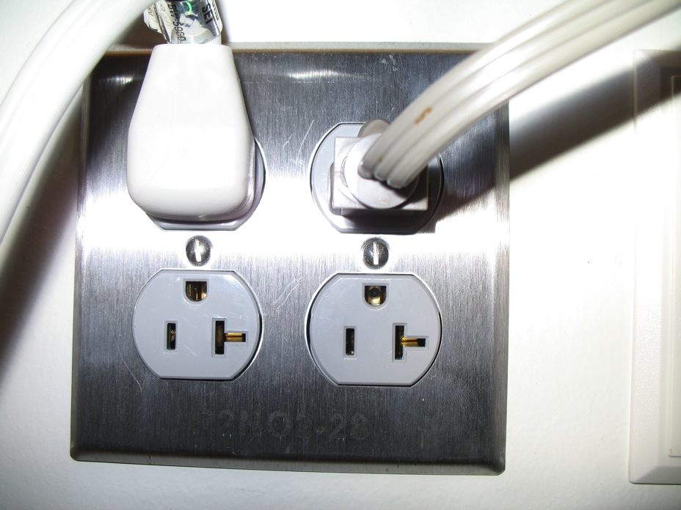
A familiar illustration
Electricity is required by many devices
Viewed as utility
Standards make things simpler
Physical configuration standards
Signaling standards – voltage, amperage, AC/DC
Notes:
Figure 3-1 from Computer Networking First-Step by Wendell Odom (ISBN: 1587201011) Copyright © 2013 Cisco Systems, Inc. All rights reserved.

Slide 19
Common ground for communication
Programs often need to exchange data
Communication
File formats
Text, Word, JPEG, PDF, etc.
Standard way of representing data as patterns of bits
Binary digits – 0 and 1
Bytes – 8 bits
All files are just collections of bits
Networks’ fundamental job is to move bits around
Often different voltages are used
One to represent 0 and another to represent 1
Sender and receiver must agree as to which is which
Encoding rules – defined by standards
Notes:
Figure 3-1 from Computer Networking First-Step by Wendell Odom (ISBN: 1587201011) Copyright © 2013 Cisco Systems, Inc. All rights reserved.

Slide 20
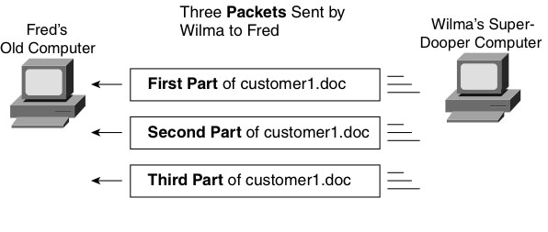
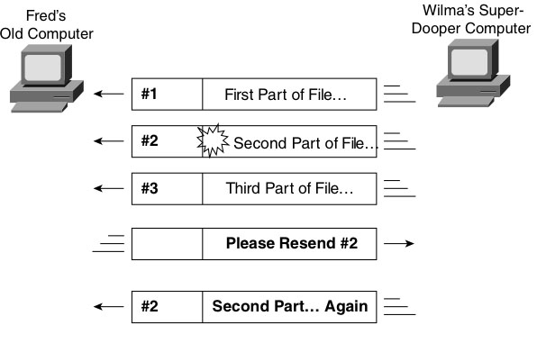
Packets
Groups of bits to be sent – like envelopes
Make transmissions more manageable
Facilitate error recovery
Electrical interference
Crosstalk – one electrical signal influences another
Can be minimized but not totally eliminated
Must be some way to identify and replace erroneous packets
Such facilities are built into networking protocols
Protocol – standardized process
Notes:
Figures 3-2 and 3-3 from Computer Networking First-Step by Wendell Odom (ISBN: 1587201011) Copyright © 2013 Cisco Systems, Inc. All rights reserved.

Slide 21
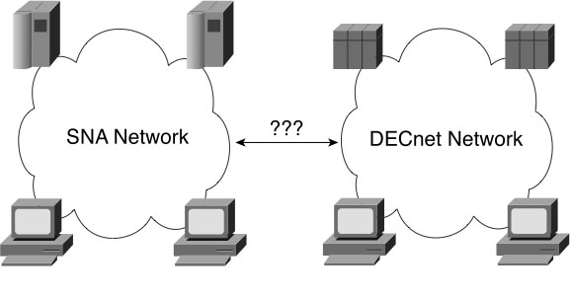
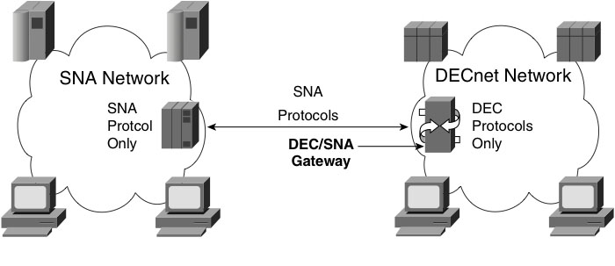
Networking models
Aka:
Networking architectural models
Networking blueprints
Network architectures
Collection of standards and protocols designed to be used together
Initially proprietary
SNA (IBM) vs. DECnet (DEC)
Gateway required for interoperability
Notes:
Figures 3-4 and 3-5 from Computer Networking First-Step by Wendell Odom (ISBN: 1587201011) Copyright © 2013 Cisco Systems, Inc. All rights reserved.

Slide 22
Public networking models
TCP/IP networking model
Encompasses several protocols
Allows all computers to communicate, regardless of manufacturer
Eventually supplanted proprietary models
Internet Engineering Task Force (IETF)
Open to all
Requests for comment (RFCs)
www.rfc-editor.org

Slide 23
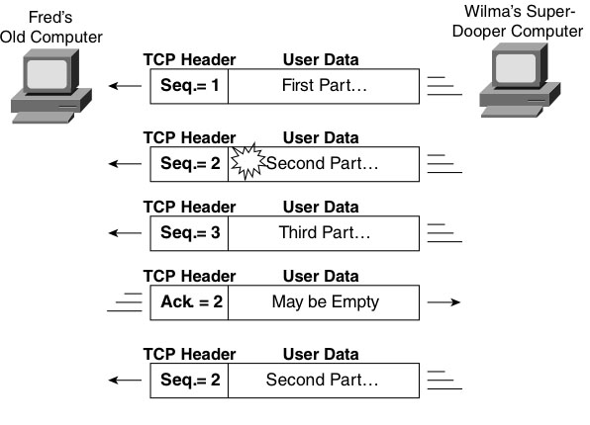
Transmission Control Protocol (TCP)
Provides error recovery
Header added to each segment (packet)
Contains sequence number
Also contains number of next packet expected
Forward acknowledgement
RFC 793
Notes:
Figure 3-6 from Computer Networking First-Step by Wendell Odom (ISBN: 1587201011) Copyright © 2013 Cisco Systems, Inc. All rights reserved.

Slide 24
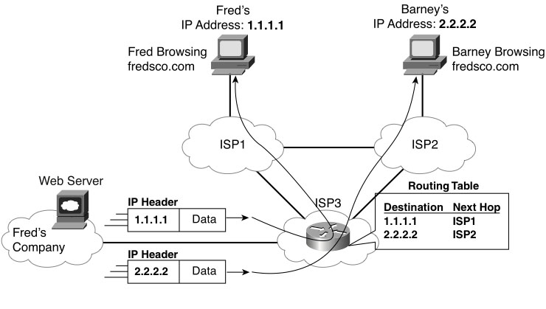
Internet Protocol (IP)
Provides logical addressing and routing
Logical addresses uniquely identify all devices
Routing moves packets from source to destination
IP adds its own headers to packets
Headers contain source address and destination address
Routers use that info to forward packets based upon their internal routing tables
Analogous to postal service
RFC 791
Notes:
Figure 3-7 from Computer Networking First-Step by Wendell Odom (ISBN: 1587201011) Copyright © 2013 Cisco Systems, Inc. All rights reserved.

Slide 25
Some standards bodies
Internet Engineering Task Force (IETF)
Most of the fundamental Internet standards
www.ietf.org
Institute of Electrical and Electronic Engineers (IEEE)
Most standards for physical transmission of bits on LANs
www.ieee.org
International Telecommunications Union (ITU)
Most standards for data transmission over WANs using leased lines
www.itu.int
International Organization for Standardization (ISO)
OSI Network Model
www.iso.org
World Wide Web Consortium (W3C or W3)
Most Web-related standards
www.w3.org
Many more…

Slide 26
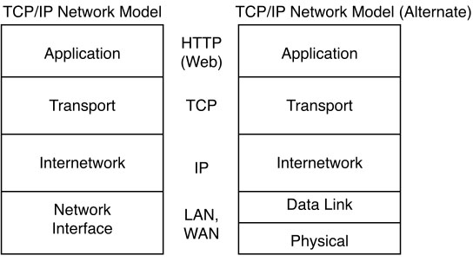
TCP/IP Network Model
Four or five layer model
Each encapsulates distinct but essential functionality
Division of labor with well-defined interfaces
Notes:
Figure 3-9 from Computer Networking First-Step by Wendell Odom (ISBN: 1587201011) Copyright © 2013 Cisco Systems, Inc. All rights reserved.

Slide 27
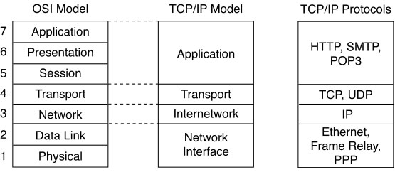
OSI Network Model
Open Systems Interconnect
Standardized by ISO
Seven layer model
Intended to be globally comprehensive
Almost never actually used in practice
But terminology is pervasive
Especially layer names and numbers
Notes:
Figure 3-10 from Computer Networking First-Step by Wendell Odom (ISBN: 1587201011) Copyright © 2013 Cisco Systems, Inc. All rights reserved.

Slide 28
Assignment of Protocols to Layers
Notes:
Definition from http://dictionary.reference.com/search?q=communication&x=33&y=25

Slide 29
Finding your application in TCP/IP
TCP and UDP introduce the concept of ports
Port – how to find “your” application to talk to
Common ports and the services that run on them:
FTP 21 and 20
telnet 23
SMTP 25
http 80
POP3 110
Apache Tomcat (TCP) 8080 - Unofficial
https://en.wikipedia.org/wiki/List_of_TCP_and_UDP_port_numbers

Slide 30
Internet Infrastructure

Slide 31
Internet Infrastructure
The infrastructure of the Internet consists of a federation of connected networks that are each independently managed (“autonomous system”)
Note: Each “autononmous system may consist of multiple IP networks
An Autonomous System (AS) is a collection of routers whose prefixes and routing policies are under common administrative control.

Slide 32
Hierarchy of network service providers
Tier-1: nation or worldwide network (US: less than 20)
Tier-2: regional networks (in US: less than 100)
Tier-3: local Internet service provider (in US: several thousand)

Slide 33
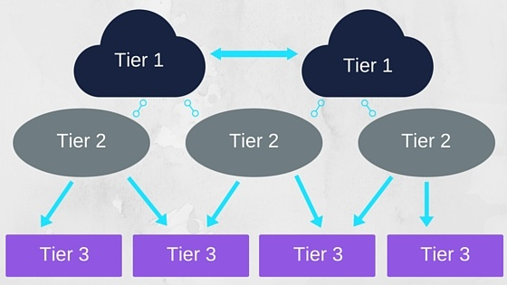
Internet Infrastructure
Hierarchical – Conceptually!

Slide 34
Tier-1 ISP: e.g., Sprint

Slide 35
Internet Backbone
Treat each other as equals
Peering – Tier-1 ISPs do not “charge” each other to carry network traffic

Slide 36
Internet Backbone
“Tier-1” commercial ISPs (e.g., Verizon, Sprint, AT&T, Qwest, Level3), national & international coverage
large content distributors (Google, Akamai, Microsoft)
IXP
IXP
tier-1 ISPs &
content distributors, interconnect (peer) privately
Tier 1 ISP
large content
distributor
(e.g., Akamai)
large content
distributor
(e.g., Google)
Tier 1 ISP
Tier 1 ISP
… or at Internet exchange points IXPs

Slide 37
IXP (IX)
Internet Exchange Point
A physical infrastructure through which Internet service providers (ISPs) and Content Delivery Networks (CDNs) exchange Internet traffic between their networks (autonomous systems).

Slide 38
Terms
PoP
Point of presence is the point at which two or more different networks or communication devices build a connection with each other. POP mainly refers to an access point, location or facility that connects to and helps other devices establish a connection with the Internet.
Terminology from “phone” days
Not to be confused with POP2 or POP3 – Post Office Protocol

Slide 39
Internet Infrastructure
Location where a network (ISP, corporate network, or regional network) gets access to the Internet at a POP.
Locations (Tier-1 or Tier-2) networks are connected for the purpose of exchanging traffic are called peering points.
Public peering: Traffic is swapped in a specific location at an IXP
Private peering: Two networks establish a direct link to each other.

Slide 40
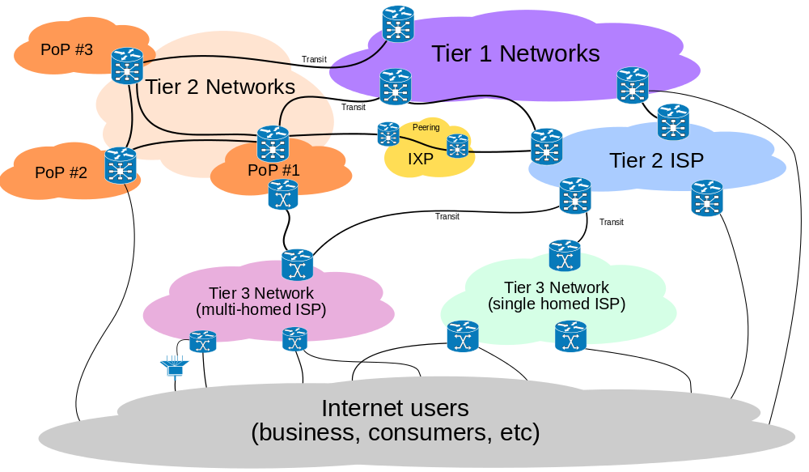
Internet Infrastructure

Slide 41
Tier-2
ISPs: smaller (often regional)
Connect to one or more tier-1 (provider) ISPs
Each tier-1 has many tier-2 customer nets
Tier-2 pays tier 1 provider
Tier-2 nets sometimes peer directly with each other (bypassing tier-1), or at IXP

Slide 42
Tier 2 ISPs
Tier-2 ISPs also peer privately with each other, interconnect at IXP
Tier-2 ISP pays tier-1 ISP for connectivity to rest of Internet
tier-2 ISP is customer of
tier-1 provider
Tier-2 ISP
Tier-2 ISP
Tier 1 ISP
IXP
Tier 1 ISP
Tier 1 ISP
Tier-2 ISP
Tier-2 ISP
Tier-2 ISP

Slide 43
Tier-3
ISPs, local ISPs
Customer of Tier-1 or Tier 2 Network
last hop (“access”) network (closest to end systems)

Slide 44
Tier-3 ISPs
local
ISP
Tier 3
ISP
local
ISP
local
ISP
local
ISP
Local and tier- 3 ISPs are customers of
higher tier ISPs
connecting them to rest of Internet
Tier-2 ISP
Tier-2 ISP
Tier 1 ISP
IXP
Tier 1 ISP
Tier 1 ISP
Tier-2 ISP
Tier-2 ISP
Tier-2 ISP
local
ISP
local
ISP
local
ISP
local
ISP

Slide 45
Internet Infrastructure
Roughly Hierarchical – Conceptually!...
But really a GRAPH!

Slide 46
Tier-1 ISP: e.g., Sprint
POP: point-of-presence
to/from backbone
…
peering
…
…
…
…
to/from customers

Slide 47
Getting From Here to There…
A packet goes through many networks.
local
ISP
Tier 3
ISP
local
ISP
local
ISP
local
ISP
Tier-2 ISP
Tier-2 ISP
Tier 1 ISP
IXP
Tier 1 ISP
Tier 1 ISP
Tier-2 ISP
Tier-2 ISP
Tier-2 ISP
local
ISP
local
ISP
local
ISP
local
ISP

